Slide 1
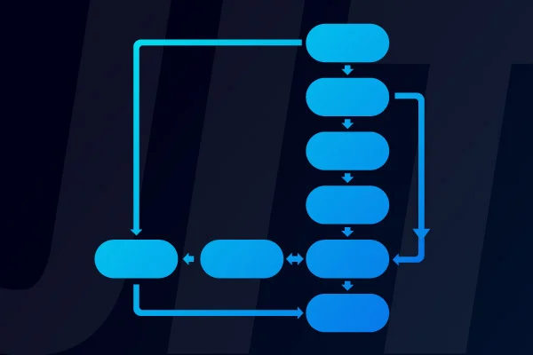

Exploring JIT in PHP
Atakan Demircioğlu

Slide 2



About Me
I'm currently working as a Full Stack Developer at @Jotform. I focus on design and implement new BI tools and features to provide better experience to customers and agents.
I'm passionate about continuous improvement, blogging, and giving back to the community.
My articles & repos are on Medium and GitHub.
Atakan Demircioglu
Full Stack Developer @Jotform
Notes:
Daha önce Growth Departmanında çalıştım.
Customer Experience Departmanında çalışıyorum.
Blog yazıları, aktif öğrenme

Slide 3
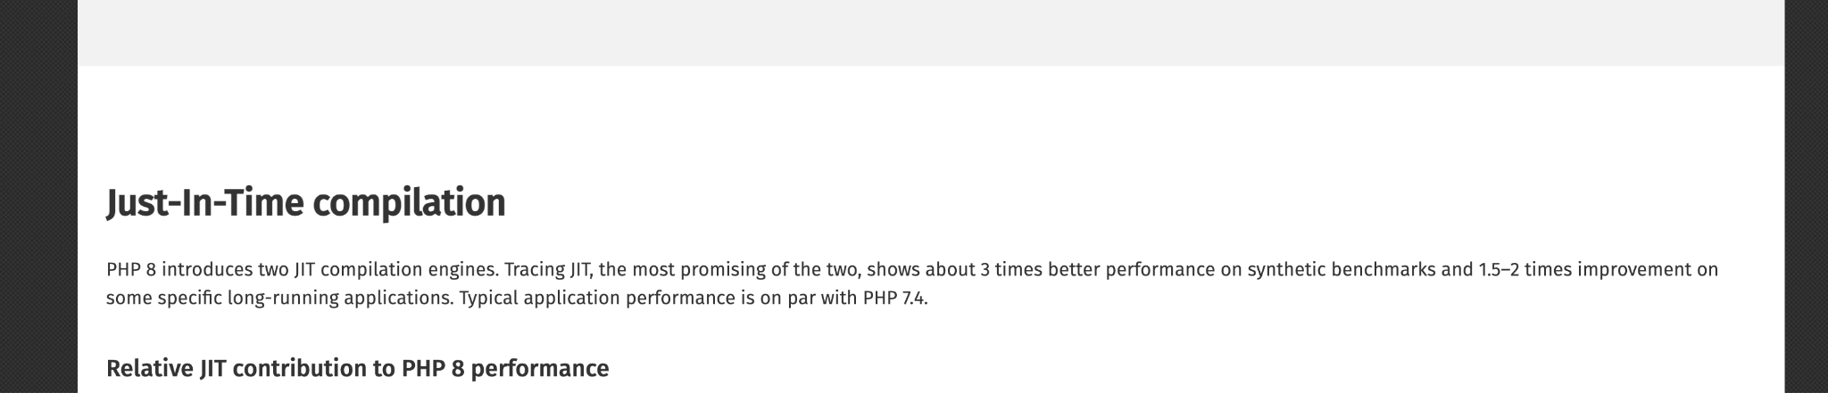

About The Topic
Notes:
Daha önce Growth Departmanında çalıştım.
Customer Experience Departmanında çalışıyorum.
Blog yazıları, aktif öğrenme

Slide 4
Agenda
History of PHP
How PHP works internally
Opcache & Preloading
JIT
Functional JIT
Tracing JIT
Performance of JIT
How to enable
Summary

Slide 5
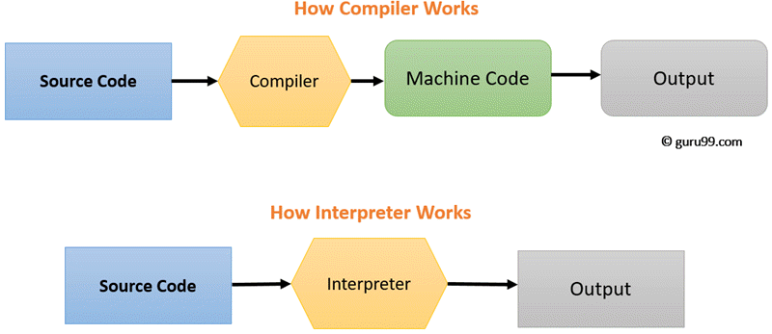
PHP’s Definition
Widely-used open source general-purpose scripting language that is especially suited for web development and can be embedded into HTML.
Scripting language is a computer language that does not need the compilation step and is rather interpreted one by one at runtime. It is where the script is written and where instructions for a run-time environment are written.
Zend Engine is the internal compiler and runtime engine for PHP.
Notes:
PHP nin scripting bir dil olması
Interpreted & Compiled dillerin farklılıkları
PHP nin internal compilerı (Zend engine)

Slide 6
History of PHP
1994
PHP was a simple set of Common Gateway Interface (CGI) binaries written in the C programming language.
1995
Rasmus released the source code for PHP Tools to the public.
1996
Rasmus introduced PHP/FI (Form Interpreter)
Notes:
CGI nedir
Rasmus başta kendi sitesinde CVsini track etmek için kullanıyordu, bu kullandığı toolları Personal Homepage Scripts adı altında topluyordu
1995 de bir google groups yazısı ile public şekilde yayınladı
Daha sonra 1996 da PHP FI ı yayınladı, burdaki amacı aslında bir template engine yaratmak ve C için bir API hazırlamaktı. Looplama function çağırma gibi çoğu özellikten eksik bir sürümdü, ancak isteklerin ve taleplerin template engine tarafında business logic olması tarafında talepler vardı

Slide 7
History of PHP
1997
Complete rewrite of the underlying parser in 1997 (PHP 3)
Renamed simply 'PHP', with the meaning becoming a recursive acronym - PHP: Hypertext Preprocessor.
Object-oriented programming support
2000
New engine -> Zend Engine introduced (PHP 4)
(comprised of their first names, Zeev and Andi)
HTTP sessions, output buffering etc.
Notes:
Sene 1997 yi gösterdiğinde, Zeev ve Andi adında iki arkadaş PHP yi Universite projesinde kullanmak üzere rewrite etti. Bu süreçlere Rasmus da dahil oldu.
Yine 1997 de bir isim değişikliğine gidildi ve FI eki kaldırıldı.
Yine bu sürümde object-oriented programlama desteği geldi (Buraları genişletebiliriz)
2000 yılı tamamen PHP nin hikayesinin değiştiği yıllardan biri diyebiliriz. VM engine olarak Zend Engine dahil oldu, yine Zeev ve Andi tarafından geliştirildi.
Yine dile Sessionlar ve output buffering gibi yeni özellikler geldi

Slide 8
History of PHP
2004
Zend Engine 2.0 introduced (PHP 5)
Improved PHP 4 in major areas;
Object-oriented programming
MySQL
XML
Notes:
PHP ile Zend Engine 2.0 hikayeye dahil oldu
PHP 4 e göre daha iyi bir Object-oriented programlama alt yapısı
Geliştirilmiş MySQL extension u
Ve yeni günçlü XML functionları katıldı

Slide 9
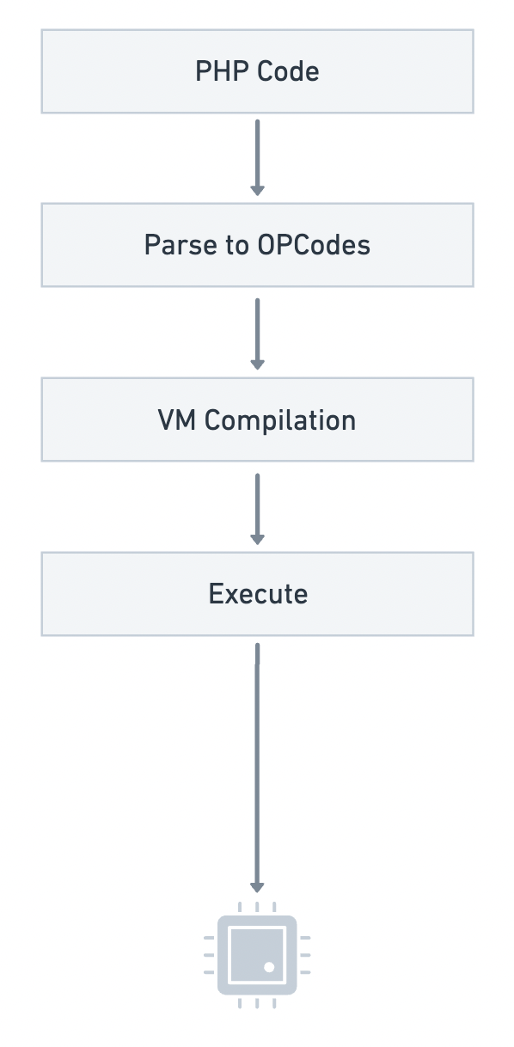
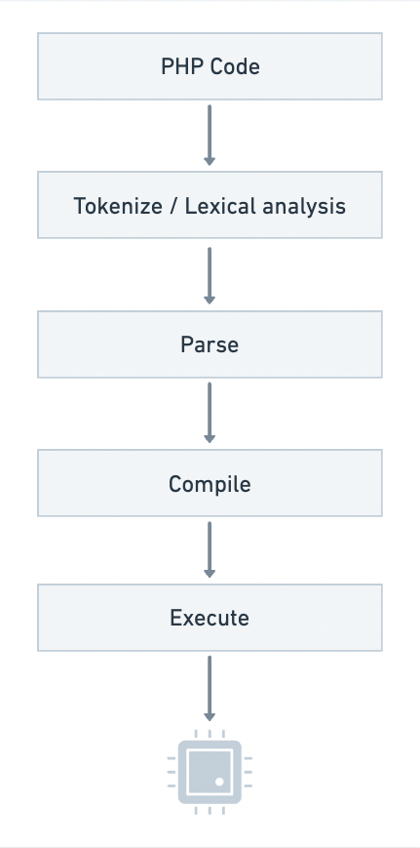
How non-optimized PHP works internally?
In simple terms, PHP works like Parse Compile Execute
Notes:
Peki PHP nasıl çalışıyor,
Aslında optimize edilmemiş, sade PHP 3 temel step ile çalışıyor.
Parsing, compiling ve execution.
Tokenize ->
Bazı yerlerde tokenizing diye de geçer.
Kaynak kodu karakterinin karakter bazında analiz edilmesini ve onu token adı verilen daha küçük anlamlı birimlere ayırmayı içerir.
Tokenlerle çalışmanın avantajı da aslında interpreter yada compiler ın daha efficient bir şekilde çalışmasını sağlar. En temelinde compile işlemi maliyetli bir iştir.
PHP bu işlemi re2c (ri tu si) adında open source bir proje ile gerçekleştiriyor. Bunun temelinde aslında regexler yatıyor ve kodu dediğim gibi karakter karakter gezerek bunları tokenlara çeviriyor.
Parse ->
Bu aşamada generate edilen tokenları aslında daha organize bir data structure a çeviriyor.
Aynı zamanda syntax checklerini de burda gerçekleştiriyor.
En sonunda AST dediğimiz Abstract Syntax Tree i çıkartıyor.
Peki bu neye benziyor dersek, bunun için tatlı bir paket var, php-ast paketiyle bunu preview etmek mümkün.
Belki bizim için çok anlamlı gözükmese de static code analysis toolları için baya faydalı olduğunu söylebiliriz.
Compile -> Op code lar oluşturuluyor, 200+ den fazla şuan opcode var. Örnek olarak IF ve SWITCH hepsi bir op code u temsil ediyor. Burda oluşturulan OpCode lar arch bağımsızdır yani evrenseldir.
Interpretation işleminin son aşaması da Execution işlemi, hazırlanan OPCode lar zend VM aracılığı ile çalıştırılıyor.
Byte Code consisting of binary, hexadecimal, macro instructions like (new, add, swap, etc) and it is not directly understandable by the CPU. It is designed for efficient execution by software such as a virtual machine.intermediate-level
Machine Code is considered as the low-level code.
Machine code is not executed by a virtual machine it is directly executed by CPU.
How does PHP run?
PHP is a "scripting language", which means it is not directly compiled into machine language.
When you start a PHP program, the Zend Engine will parse the code into an abstract syntax tree (AST) and translate it to opcodes. The opcodes are execution units for the Zend Virtual Machine (Zend VM). Opcodes are pretty low-level, so much faster to translate to machine code than the original PHP code. PHP has an extension named OPcache in core, to cache these opcodes.
The first run of a PHP program it has to go from PHP code to opcodes, but the next runs will use the cached opcodes. For obvious reasons, always make sure Zend OPcache is loaded and enabled.
So, that's the current state of PHP execution, in a nutshell.
In summary, basic lexical errors are typically caught during tokenization, while more complex syntax errors are checked during parsing.
This is the last phase of the interpretation process. At this stage, you actually run the generated OPCode on the Zend virtual machine (Zend Engine VM).

Slide 10
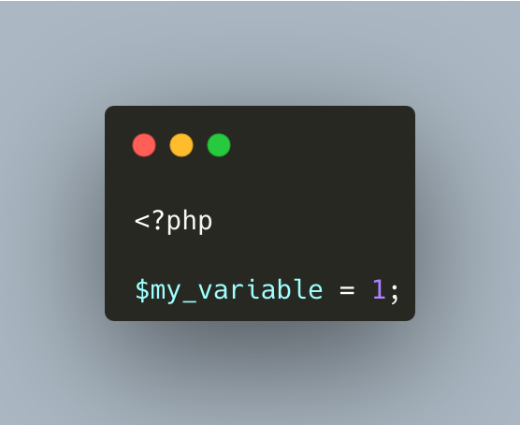
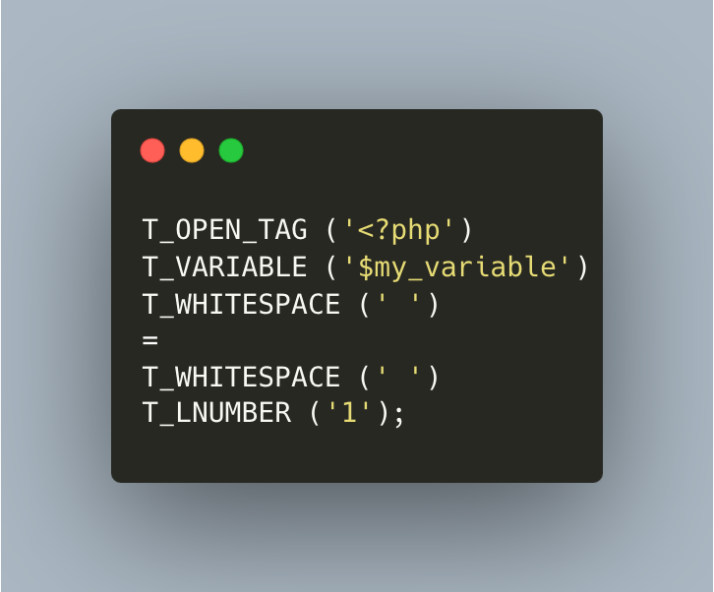
Lexical Analysis (Lexing)
re2c (free open-source lexer generator)
Removes comments in this part
Some characters like =, ;, :, ? are considered tokens by themselves
Notes:
Lexical analysis (Lexing)
Bazı yerlerde tokenizing diye de geçer.
Kaynak kodu karakterinin karakter bazında analiz edilmesini ve onu token adı verilen daha küçük anlamlı birimlere ayırmayı içerir.
Tokenlerle çalışmanın avantajı da aslında interpreter yada compiler ın daha efficient bir şekilde çalışmasını sağlar. En temelinde compile işlemi maliyetli bir iştir.
PHP bu işlemi re2c (ri tu si) adında open source bir proje ile gerçekleştiriyor. Bunun temelinde aslında regexler yatıyor ve kodu dediğim gibi karakter karakter gezerek bunları tokenlara çeviriyor.
re2c is a free and open-source lexer generator for C/C++, Go and Rust with a focus on generating fast code.
https://www.droptica.com/blog/how-php-interpreter-works/
https://www.zend.com/blog/exploring-new-php-jit-compiler

Slide 11
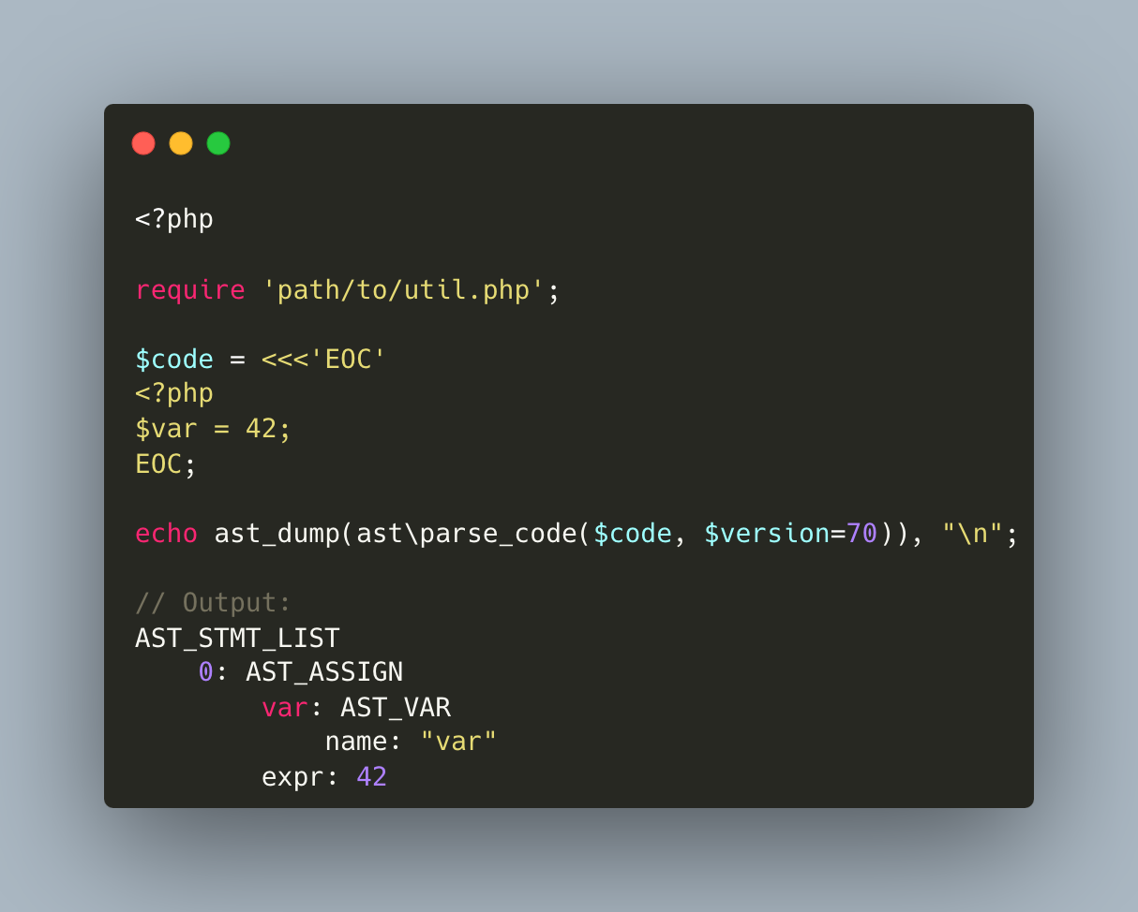
Syntax Analysis (Parsing)
Checks to see if the script matches the syntax rules
Uses tokens to build an Abstract Syntax Tree
Using the php-ast extension it is possible to preview such a structure example
Notes:
Syntax analysis (parsing)
Bu aşamada generate edilen tokenları aslında daha organize bir data structure a çeviriyor.
Aynı zamanda syntax checklerini de burda gerçekleştiriyor.
En sonunda AST dediğimiz Abstract Syntax Tree i çıkartıyor.
Peki bu neye benziyor dersek, bunun için tatlı bir paket var, php-ast paketiyle bunu preview etmek mümkün.

Slide 12
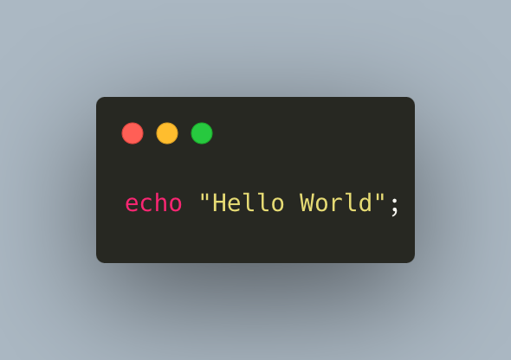
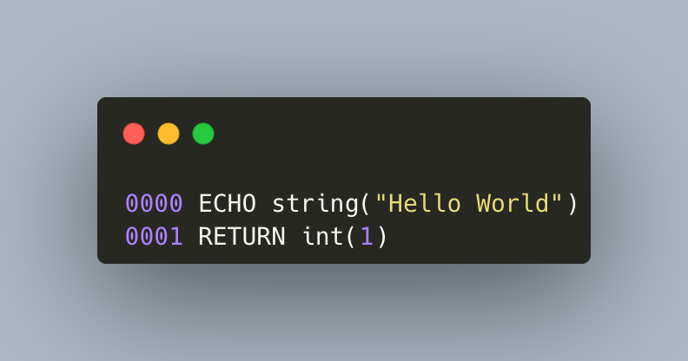
Compilation
PHP's internal Opcache extension
phpdbg debugger
Vulcan Logic Dumper (VLD) PECL extension provide easy ways to dump all the Opcodes for a given snippet or a file.
Notes:
PHP nin standart compile işleminde, daha önceki aşamada oluşturduğumuz AST yi aslında OPCode lara çevriliyor.
Burda oluşturulan OpCode lar arch bağımsızdır yani evrenseldir.
Opcode yani diğer bir deyimle byte code

Slide 13
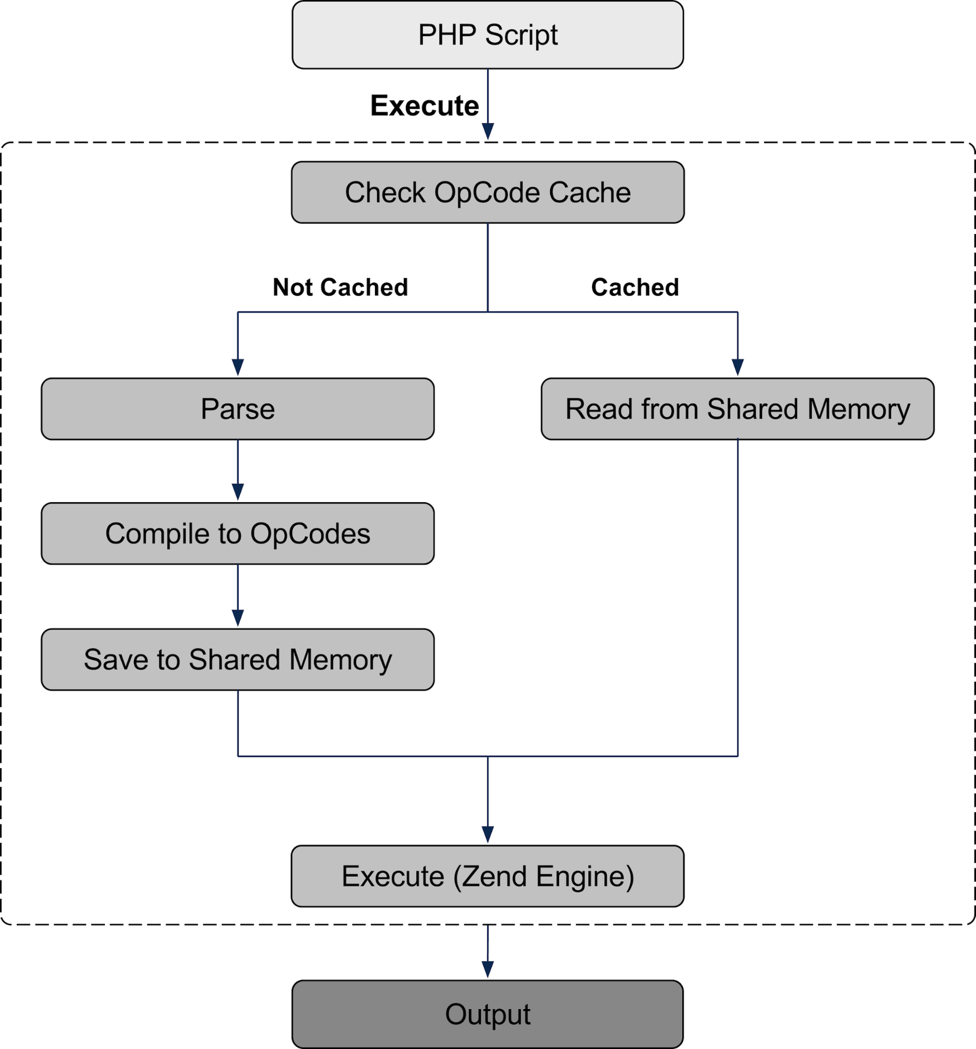
OPcache
Introduced with PHP 5.5
Before PHP 5.5 (eAccelerator, APC, XCache makes similar things)
OPcache stores precompiled script bytecode in shared memory
Cache invalidated if file changes
Memory limited

Slide 14
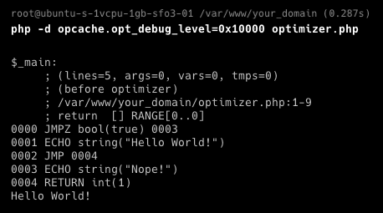
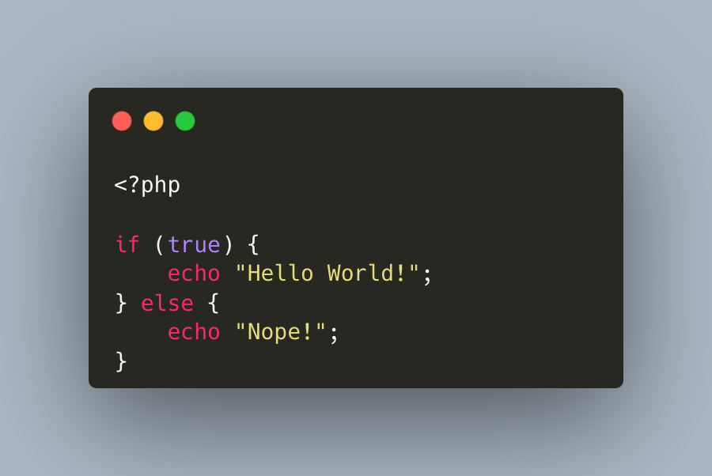
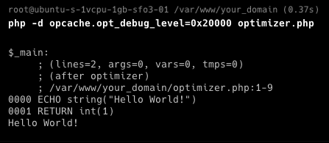
Opcode Optimizer Examples #1
Notes:
Her türlü ilk condition true geldiği için, else kısmını çıkartıyor.

Slide 15
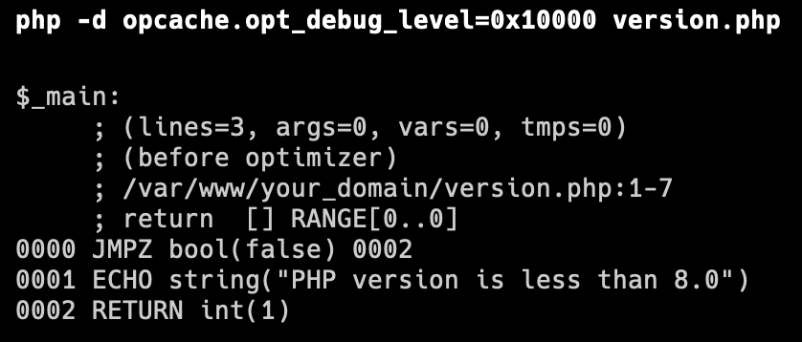
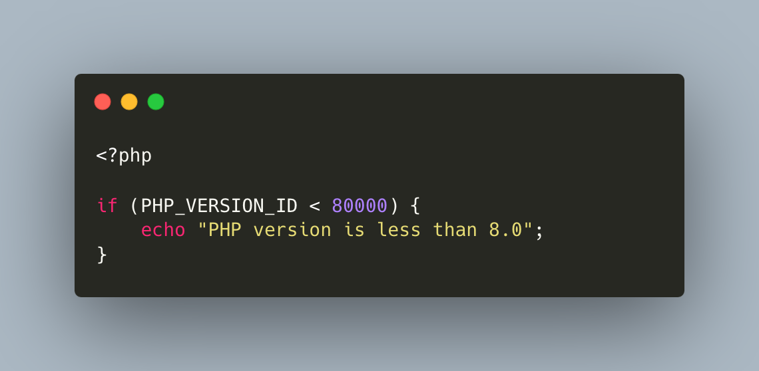
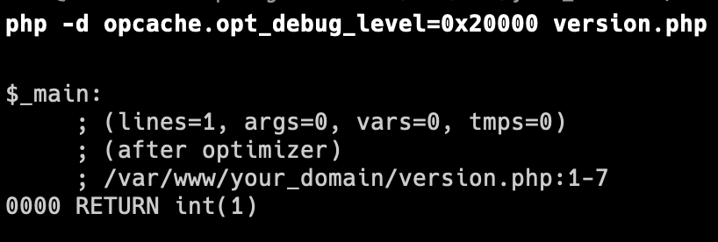
Opcode Optimizer Examples #2
Notes:
Kullanılan PHP versionunu bildiği için, gereksiz blockları kaldırıyor.

Slide 16

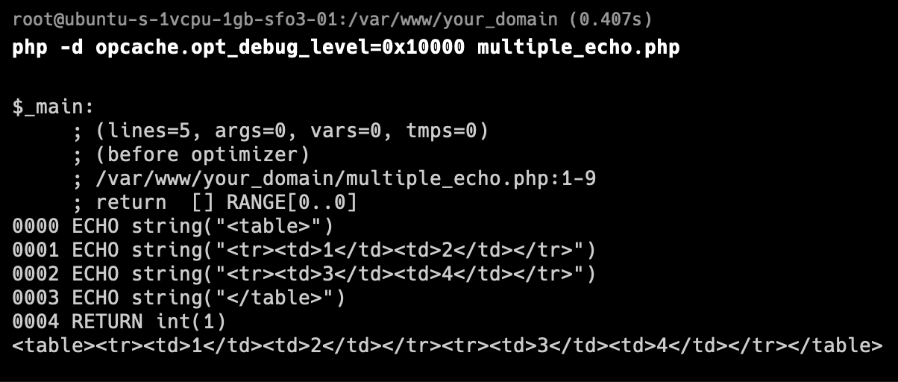
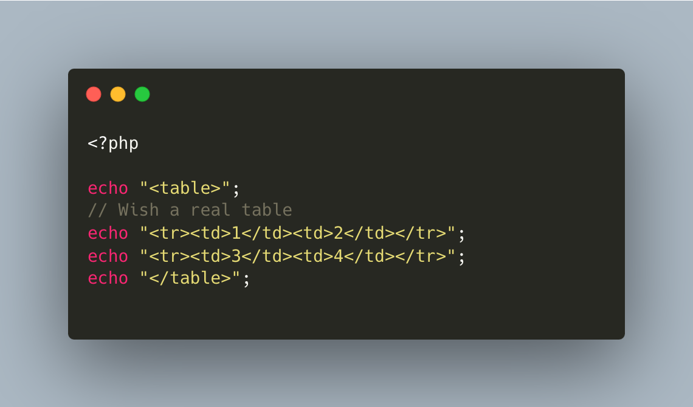
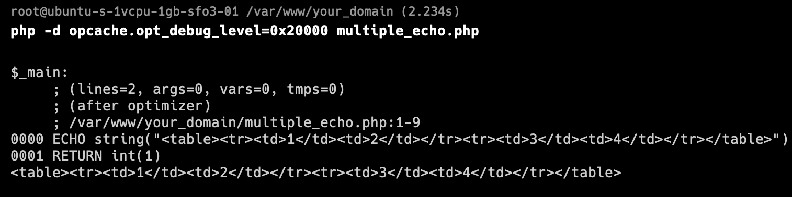
Opcode Optimizer Examples #3
Notes:
Kullanılan PHP versionunu bildiği için, gereksiz blockları kaldırıyor.
as part of which some optimisations are made as well. Most often, simple arithmetic calculations are performed, or the expressions such as strlen("test") are replaced with a direct int(4) value.

Slide 17
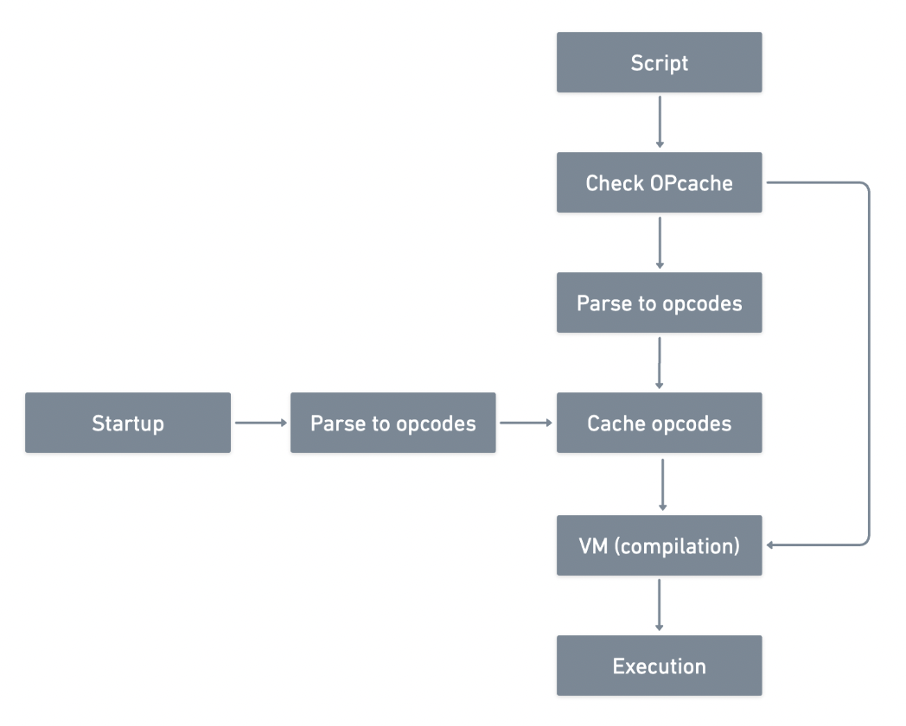
Preloading
PHP 7.4 introduced opcache preloading
Allows administrators to specify scripts that should be pre-compiled during the startup (PHP-FPM, mod_php, etc.)
Most frameworks are bootstrap heavy
Notes:
For preloading files, a custom PHP script is needed
The preloading script is executed once after PHP-FPM start/restart
All preloaded files are stored and available in memory for all requests
Changes made to preloaded files won't have any effect until PHP-FPM restart

Slide 18
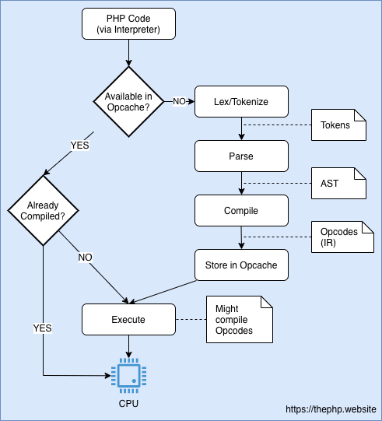
JIT
Implemented by Dmitry Stogov
Think of it like an extra layer of caching: caching of the native machine code
DynASM, which is the underlying assembler used in PHP JIT
JIT is implemented as part of Opcache, and requires the Opcache extension to be enabled.
Notes:
IDEA: You skip all about OPCache entirely
2 temel farklı yolu var,
Function JIT
Tracing JIT
PHP 8.0's JIT implementation uses DynASM for its code generation. PHP's JIT is bound by the limitations of DynASM for target processor architectures.
When we looked originally at the OPcache, we found it removed the parsing and compilation steps that gave us opcodes for the VM. However, the VM still needed to compile these to native machine code.
The implementation of JIT in PHP uses a library called DynASM (Dynamic Assembler), which maps a set of CPU instructions in one specific format into assembly code for many different CPU types. That way, JIT can transform Opcodes into architecture-specific machine code using DynASM.

Slide 19
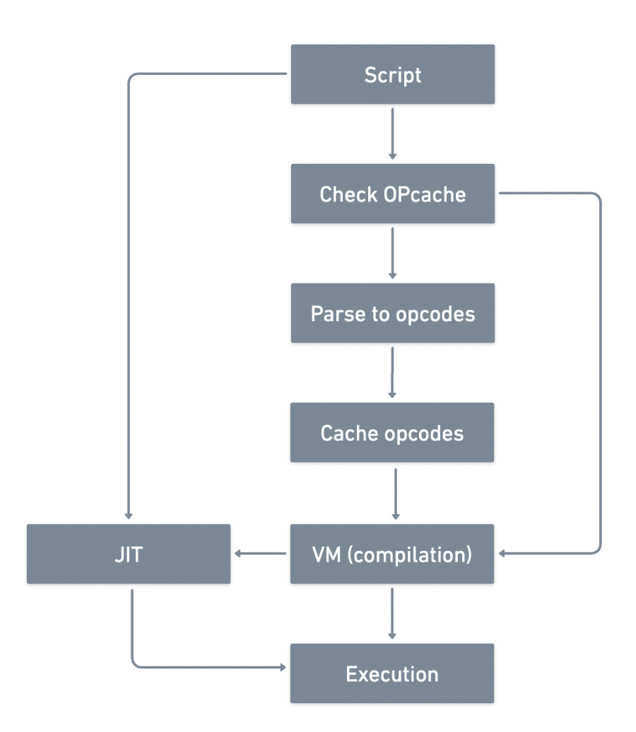
Function JIT
It analyzes each function, attempting to optimize and compile each path through it
Excludes tracing for frequently used code structures like loops
Notes:
Bütün kod parçaları VM den JIT e analiz edilmesi için paslanıyor. Her fonksiyon analiz edilip sonrasında optimize ve compile edilmeye çalışılıyor.

Slide 20
Function JIT Problems
Generally only improves the performance of CPU bound apps
JIT works better with strict types (use strict_types = 1)
Function based JIT can’t refer objects
JIT is useful with real hot-spots
Don’t check whether the code is frequently used or not
Need a smarter way
Notes:
DB ye erişmek, HTTP servislerine erişmek, File System e erişmek I/O bound işlerdir.
Hiç kullanılmayacak kodları bile cachelemeye çalışır, buda overhead yaratabilir.

Slide 21
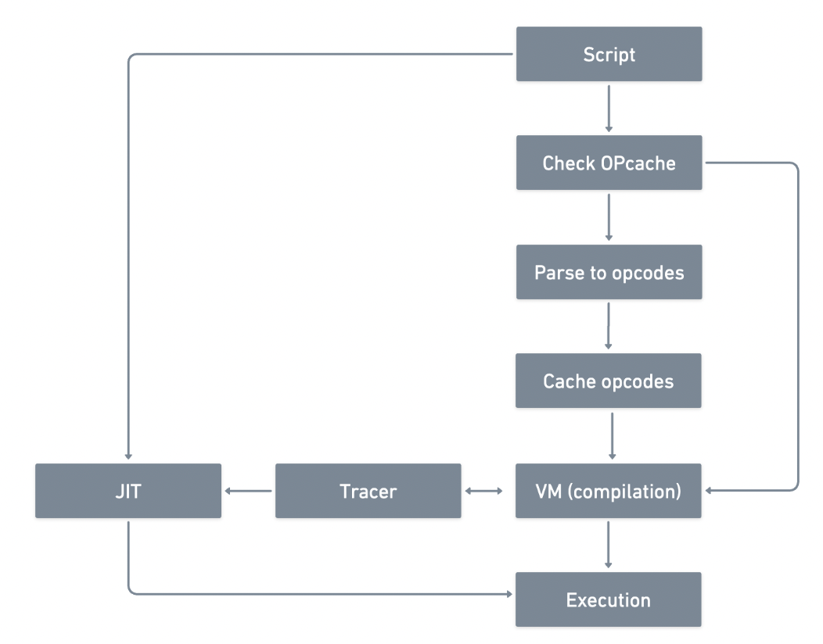
Tracing JIT
Selected by default in PHP 8.0
Based on; - How often a trace is called - How long it is - What operations it performs
JIT decides if the code can benefit from compilation.
Notes:
Tries to identify the frequently used parts of code, and selectively compiles those structures for the best balance of compilation time and memory usage
There are several configuration options that enable further tweaking how a hot code structure is determined, such as the number of function calls, number of iterations of a loop structure, etc.
With this approach, as the JIT encounters code, it creates a "trace", which includes the actual VM instructions (opcodes), as well as additional runtime information such as the types of operands used, what classes were in the context, and what functions, methods, or closures were called.
Based on the how often a trace is called, how long it is, and what operations it performs, the JIT decides if the code can benefit from compilation.

Slide 22
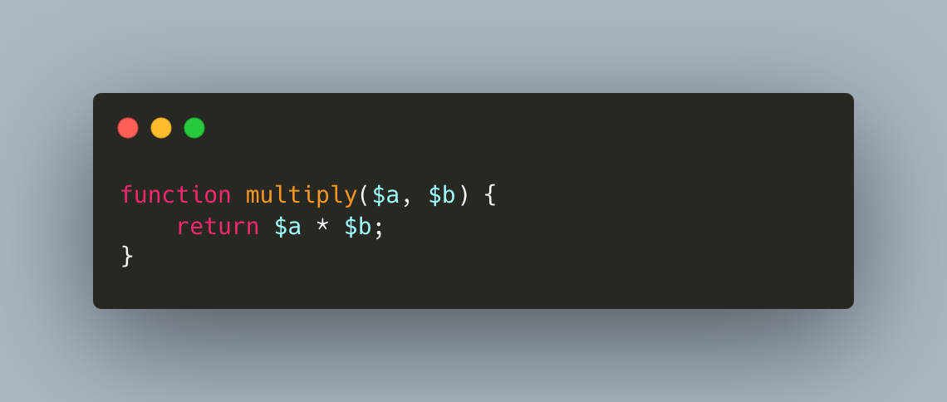
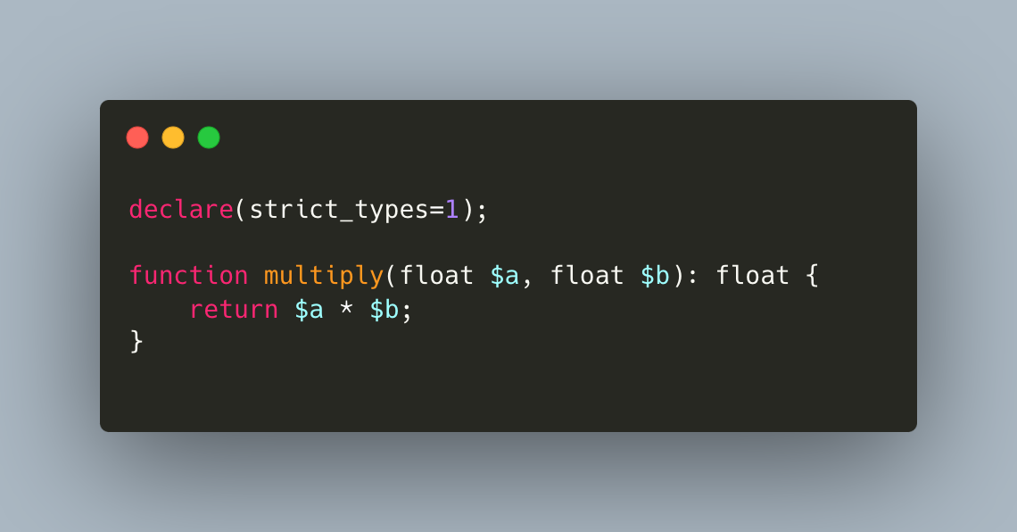
JIT Friendly Code
Strictly typed code and functions with scalar types can help JIT to infer types and make use of CPU registers and specialized
use declare(strict_types=1);

Slide 23
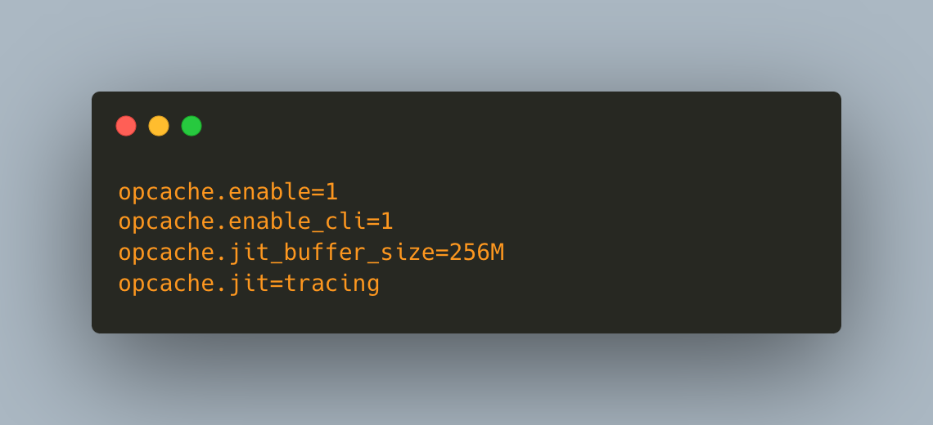
How Do I Get Started
By default, JIT is enabled, but it is turned off by limiting the buffer size.

Slide 24
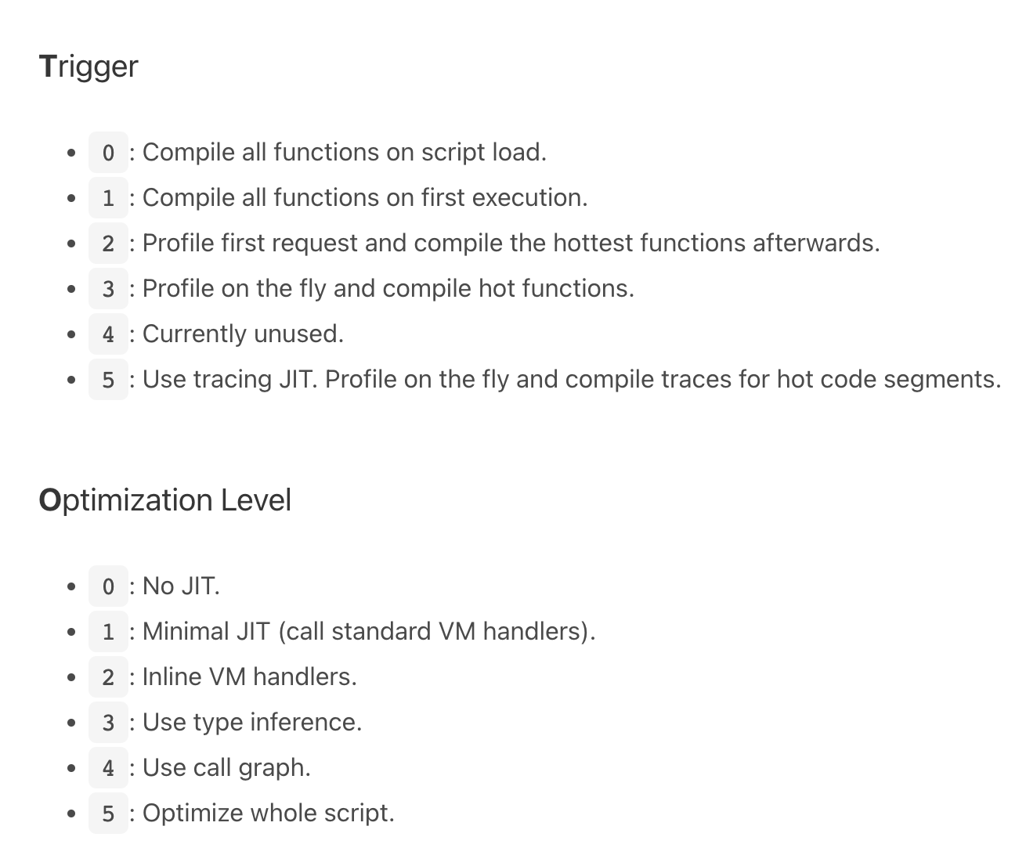
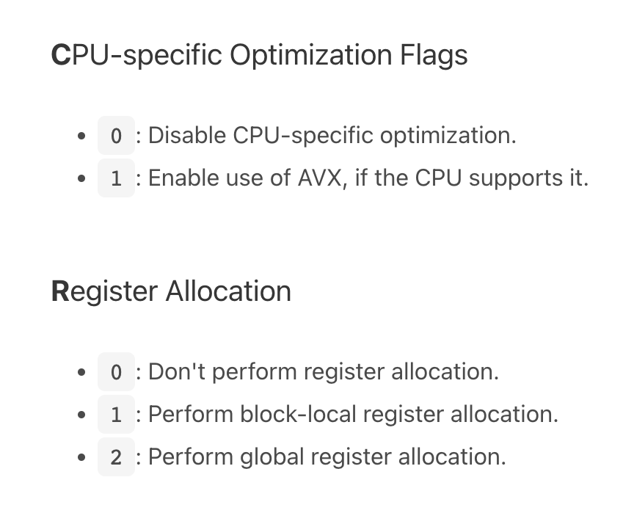
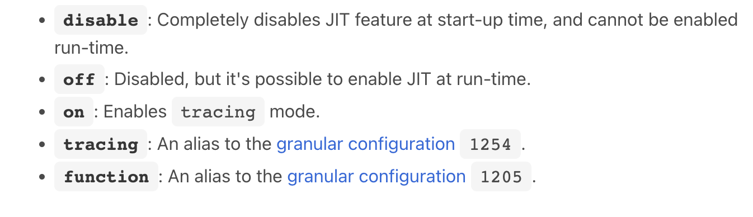
JIT Flags
The opcache.jit directive accepts a 4-digit value to control the JIT behavior.
In the form of CRTO, and accepts following values for C, R, T, and O positions.
Notes:
AVX stands for "Advanced Vector Extensions," and it refers to a set of CPU instructions designed to improve the performance of floating-point and vector operations in processors. AVX is an extension of the x86 instruction set architecture used in modern CPUs.
Local Linear-Scan Register Allocator: Allocates registers on a basic block-by-basic block basis, without considering interactions between different basic blocks. This approach is relatively simple and efficient for optimizing register usage within isolated sections of code.
Global Linear-Scan Register Allocator: Takes a broader view of the entire program or function, considering the interactions between different basic blocks. This approach can lead to more sophisticated and potentially more optimal register allocation decisions by taking into account the control flow and data dependencies across multiple blocks.
The choice between these two strategies depends on various factors, including the complexity of the program, the available hardware resources, and the goals of the optimization process.
In summary, CPU registers are crucial components of a processor, providing high-speed storage for temporary data and playing a central role in executing instructions and performing calculations.
Triggerdaki 4 unsed, ilerde @jit docblock ile kullanmak için ayrımışlar.

Slide 25
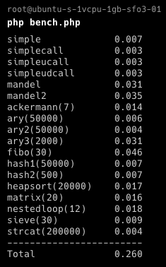
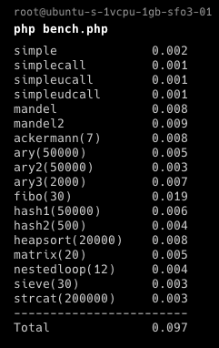
Performance with JIT
3x faster in PHP Benchmark Suite
WordPress 3.5% faster
PHP-Parser %30 faster according Nikita Popov
1 GB Memory / 25 GB Disk / SFO3 - Ubuntu 22.04 (LTS) x64 (Digital Ocean Droplet)
Notes:
Tries to identify the frequently used parts of code, and selectively compiles those structures for the best balance of compilation time and memory usage
There are several configuration options that enable further tweaking how a hot code structure is determined, such as the number of function calls, number of iterations of a loop structure, etc.
With this approach, as the JIT encounters code, it creates a "trace", which includes the actual VM instructions (opcodes), as well as additional runtime information such as the types of operands used, what classes were in the context, and what functions, methods, or closures were called.
Based on the how often a trace is called, how long it is, and what operations it performs, the JIT decides if the code can benefit from compilation.
JIT significantly improves code execution performance in CPU-intensive applications. This is about using PHP for completely new purposes, such as machine learning, complex mathematical calculations, or 2D/3D image processing/modelling.

Slide 26
Summary
If not getting worse performance, you can turn it ON.
Use Opcache enabled
Use Static Analysis Tools
Use Strict Types
Use the smarter version (Tracing JIT)
Notes:
AVX stands for "Advanced Vector Extensions," and it refers to a set of CPU instructions designed to improve the performance of floating-point and vector operations in processors. AVX is an extension of the x86 instruction set architecture used in modern CPUs.
Local Linear-Scan Register Allocator: Allocates registers on a basic block-by-basic block basis, without considering interactions between different basic blocks. This approach is relatively simple and efficient for optimizing register usage within isolated sections of code.
Global Linear-Scan Register Allocator: Takes a broader view of the entire program or function, considering the interactions between different basic blocks. This approach can lead to more sophisticated and potentially more optimal register allocation decisions by taking into account the control flow and data dependencies across multiple blocks.
The choice between these two strategies depends on various factors, including the complexity of the program, the available hardware resources, and the goals of the optimization process.
In summary, CPU registers are crucial components of a processor, providing high-speed storage for temporary data and playing a central role in executing instructions and performing calculations.

Slide 27

Feedbacks

